Slide 1
Machine Learning
Python

Slide 2
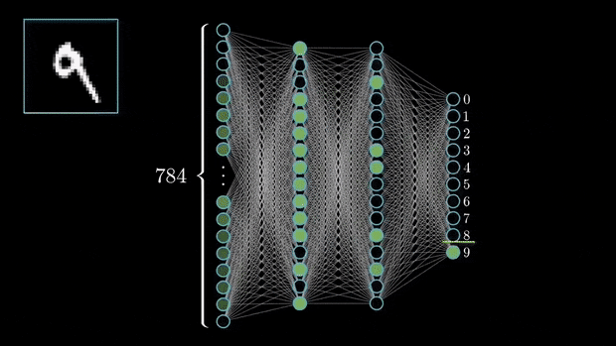

Slide 3
AI
According to a study by McKinsey, AI and machine learning is estimated to create an additional 13 trillion US dollars of value annually by the year 2030.

Slide 4
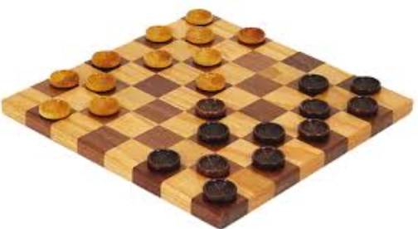
What is machine learning?
Machine learning is the subfield of computer science that gives “computers the ability to learn without being explicitly programmed.”
Arthur Samuel
American pioneer in the field of computer gaming and artificial intelligence, coined the term “machine learning” in 1959 while at IBM.

Slide 5
What is Machine Learning?
“Learning is any process by which a system improves performance from experience.” - Herbert Simon
Definition by Tom Mitchell (1998): Machine Learning is the study of algorithms that • improve their performance P • at some task T • with experience E. A well-defined learning task is given by <P, T, E>.

Slide 6
Defining the Learning Task
Improve on task T, with respect to performance metric P, based on experience E
T: Playing checkers P: Percentage of games won against an arbitrary opponent E: Playing practice games against itself
T: Recognizing hand-written words P: Percentage of words correctly classified E: Database of human-labeled images of handwritten words
T: Driving on four-lane highways using vision sensors P: Average distance traveled before a human-judged error E: A sequence of images and steering commands recorded while observing a human driver.
T: Categorize email messages as spam or legitimate. P: Percentage of email messages correctly classified. E: Database of emails, some with human-given labels

Slide 7
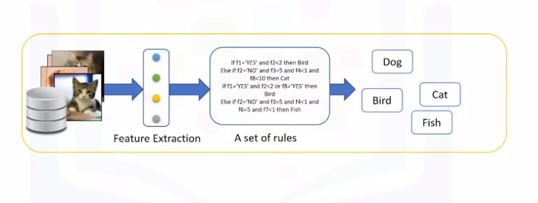
How machine learning works?

Slide 8
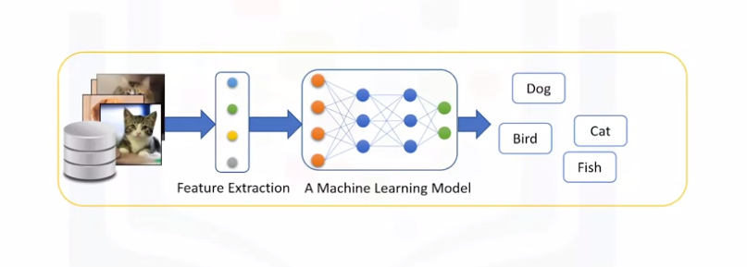
How machine learning works?

Slide 9
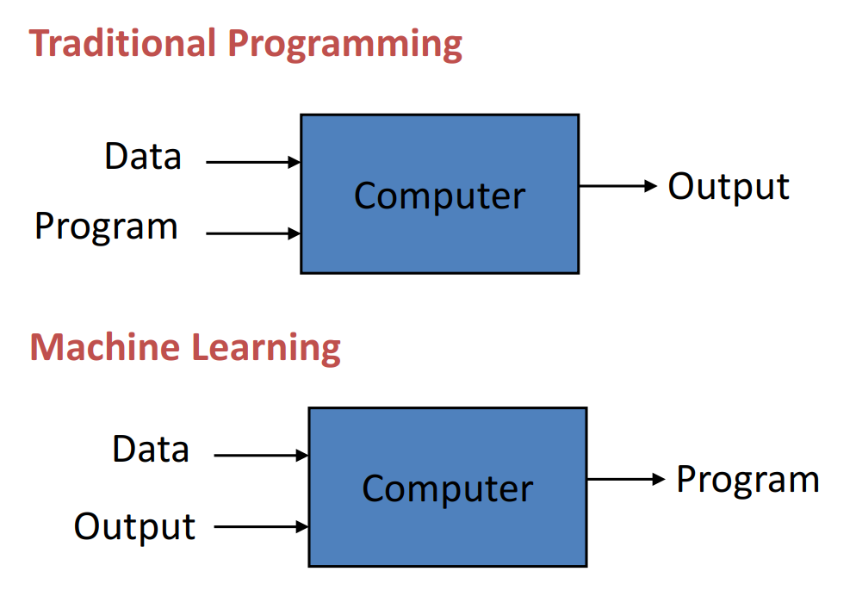
How machine learning works?

Slide 10

Examples of machine learning

Slide 11
More Examples of machine learning
Recognizing patterns: – Facial identities or facial expressions – Handwritten or spoken words – Medical images
• Generating patterns: – Generating images or motion sequences
• Recognizing anomalies: – Unusual credit card transactions – Unusual patterns of sensor readings in a nuclear power plant
• Prediction: – Future stock prices or currency exchange rates

Slide 12

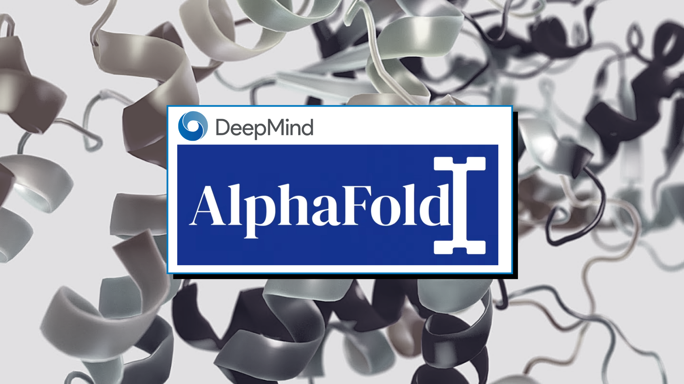


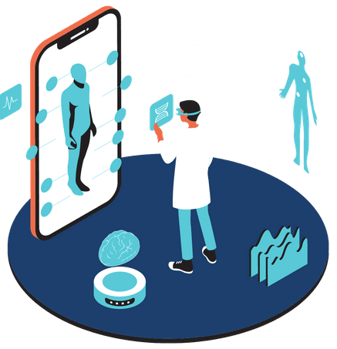
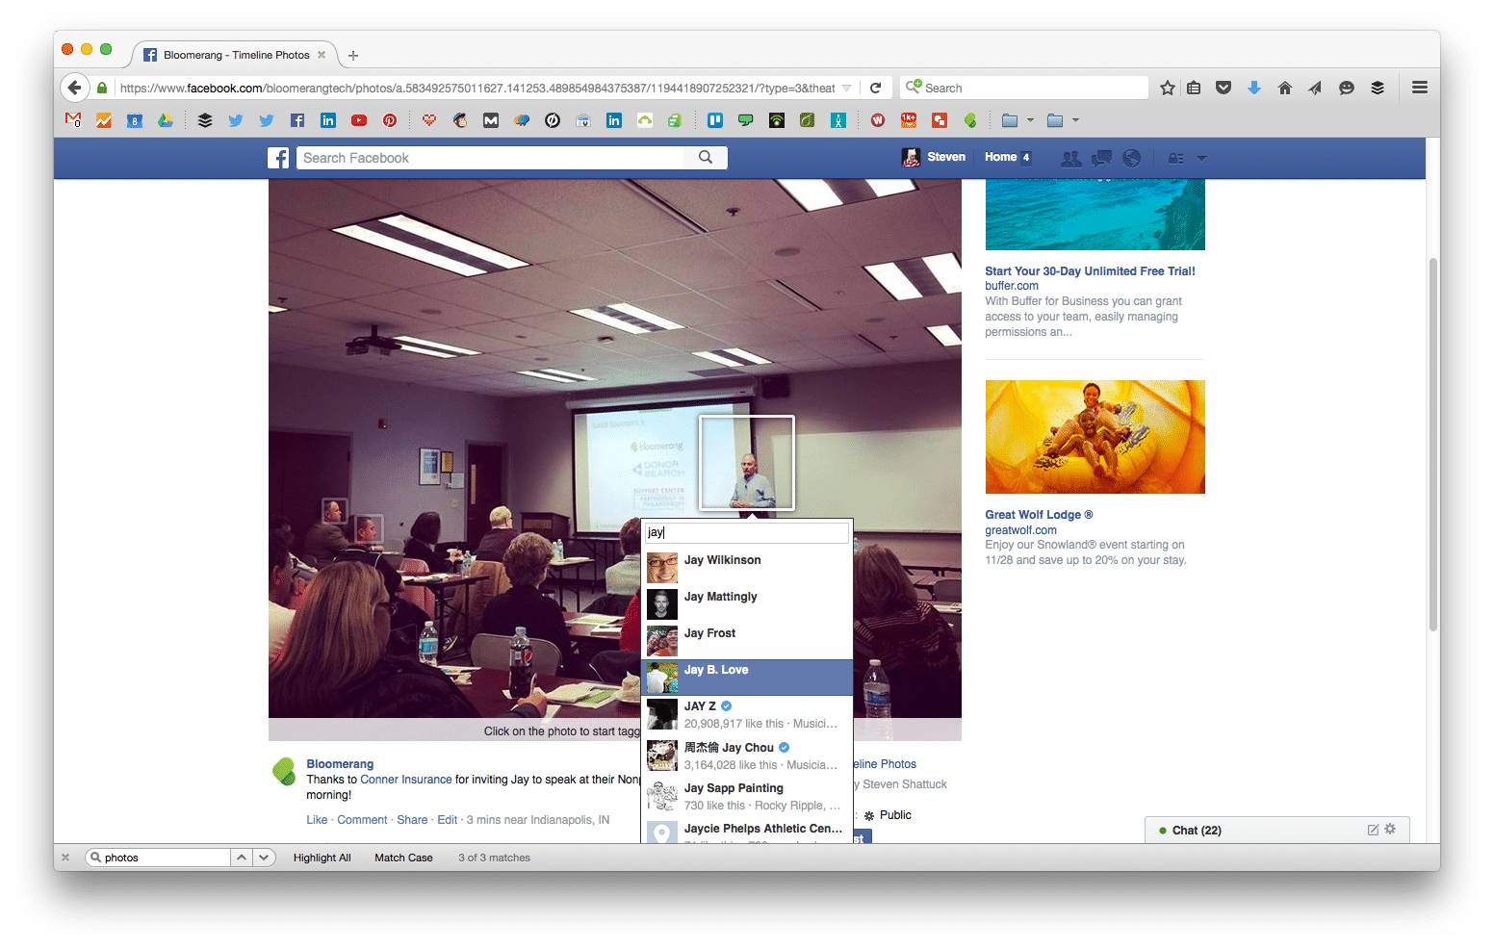
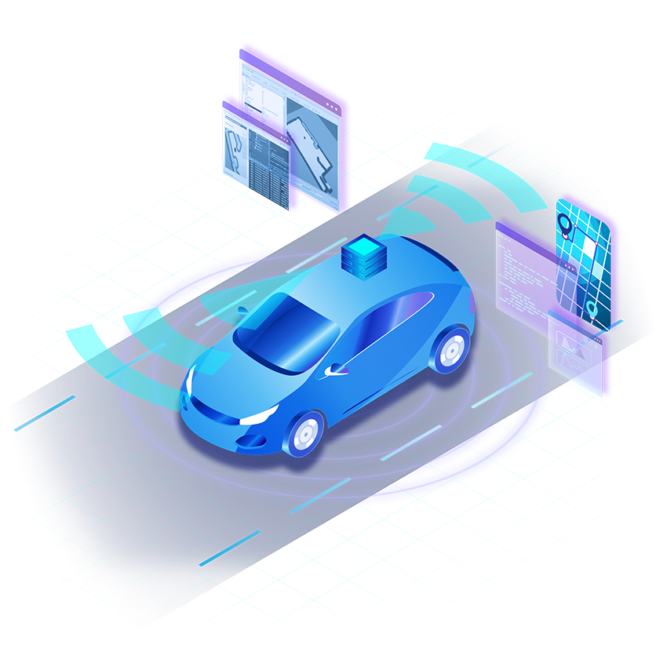

Sample Applications
Web search
• Computational biology • Finance • E-commerce • Space exploration • Robotics • Information extraction • Social networks • Debugging software • [Your favorite area]

Slide 13
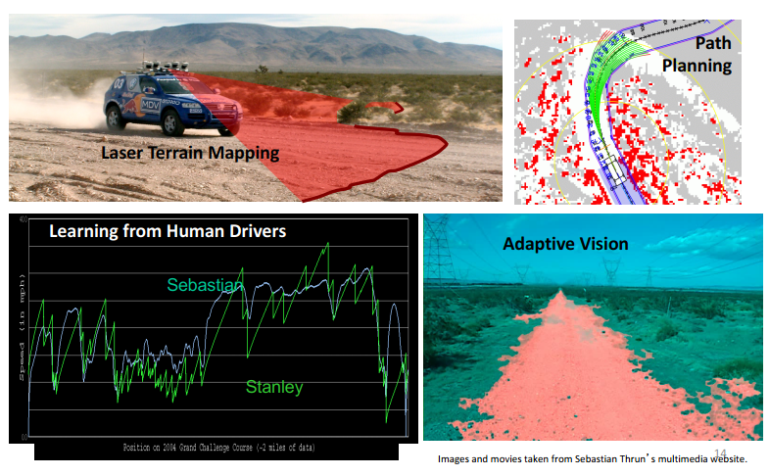
Autonomous Car Technology

Slide 14
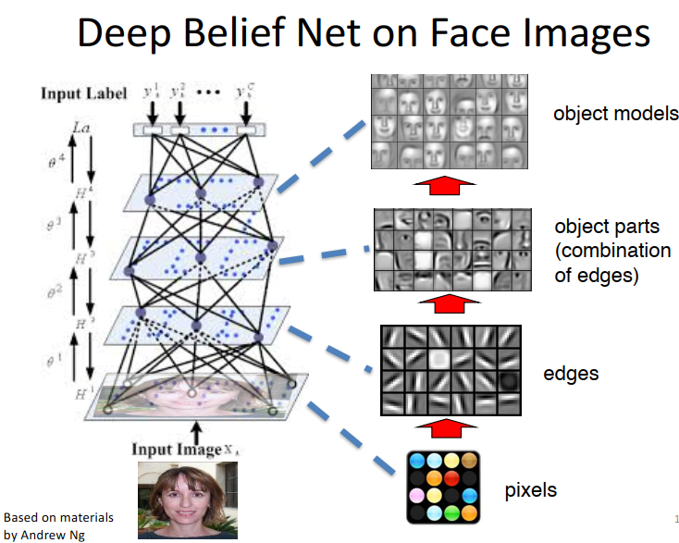

Slide 15
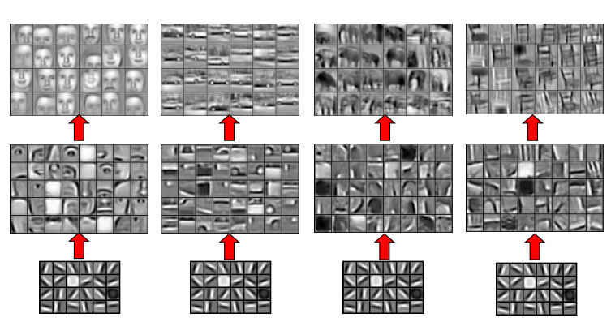
Learning of Object Parts

Slide 16
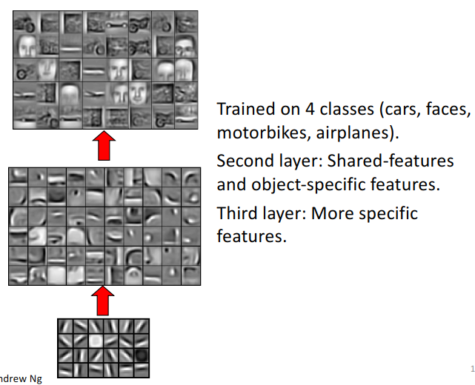
Training on Multiple Objects

Slide 17
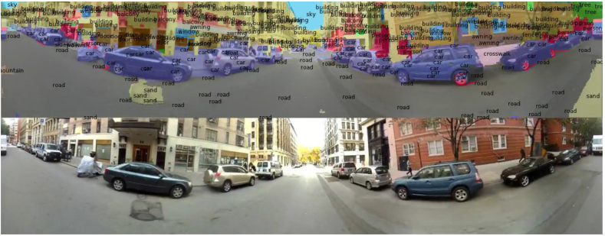
Scene Labeling via Deep Learning

Slide 18
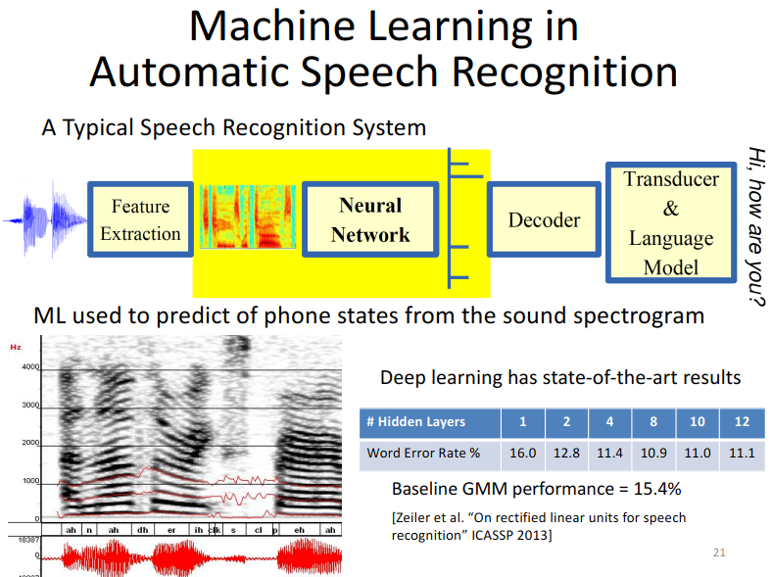


Slide 19
Major machine learning techniques
Regression/Estimation
Predicting continuous values
Classification
Predicting the item class/category of a case
Clustering
Finding the structure of data; summarization
Associations
Associating frequent co-occurring items/events

Slide 20
Major machine learning techniques
Anomaly detection
Discovering abnormal and unusual cases
Sequence mining
Predicting next events; click-stream (Markov Model, HMM)
Dimension Reduction
Reducing the size of data (PCA)
Recommendation systems
Recommending items

Slide 21
Difference between artificial intelligence, machine learning, and deep learning
AI components:
Computer vision
Language Processing
Creativity
Etc
Machine Learning:
Classification
Clustering
Neural Network
Etc
Revolution in ML:
Deep Learning

Slide 22
Types of Learning
• Supervised learning – Given: training data + desired outputs (labels) • Unsupervised learning – Given: training data (without desired outputs) • Semi-supervised learning – Given: training data + a few desired outputs • Reinforcement learning – Rewards from sequence of actions

Slide 23
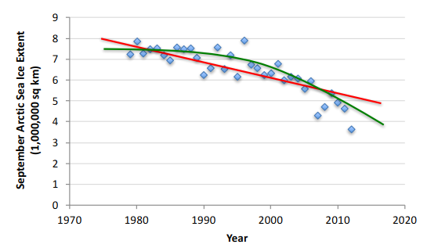
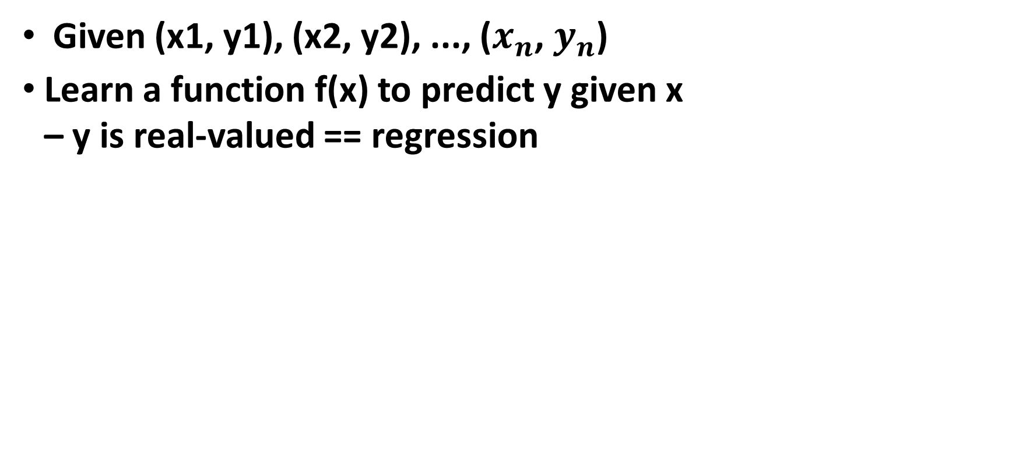
Supervised Learning: Regression
Given (x1, y1), (x2, y2), ..., ($x_{n}$, $y_{n}$)
Learn a function f(x) to predict y given x – y is real-valued == regression

Slide 24
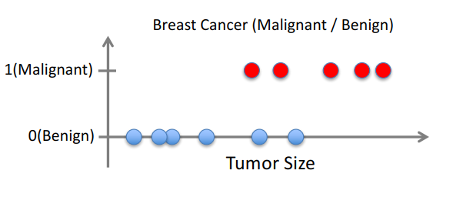
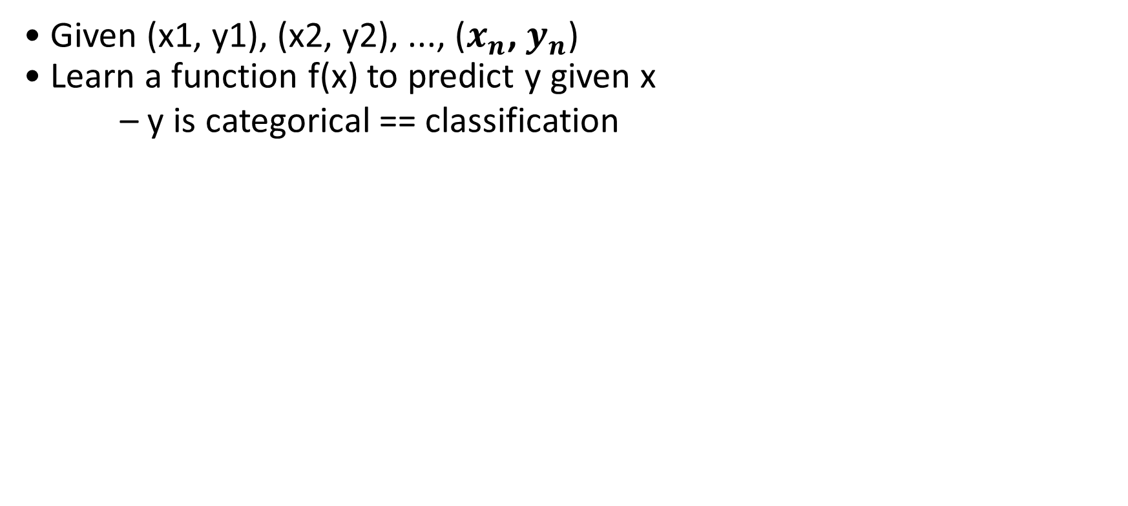
Supervised Learning: Classification
• Given (x1, y1), (x2, y2), ..., ($x_{n}$, $y_{n}$) • Learn a function f(x) to predict y given x – y is categorical == classification

Slide 25
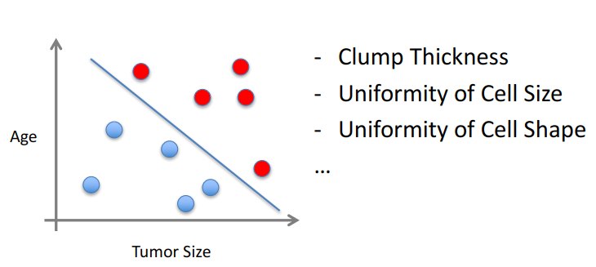
Supervised Learning
• x can be multi-dimensional – Each dimension corresponds to an attribute

Slide 26
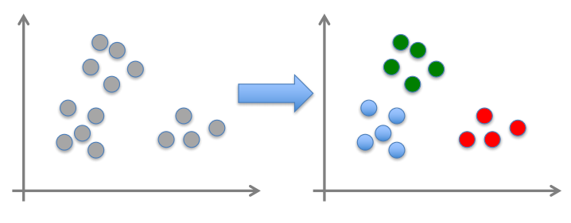
Unsupervised Learning
• Given x1, x2, ..., xn (without labels) • Output hidden structure behind the x’s – E.g., clustering

Slide 27
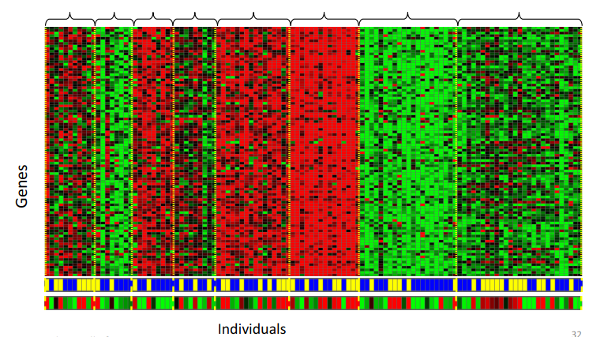
Unsupervised Learning
Genomics application: group individuals by genetic similarity

Slide 28
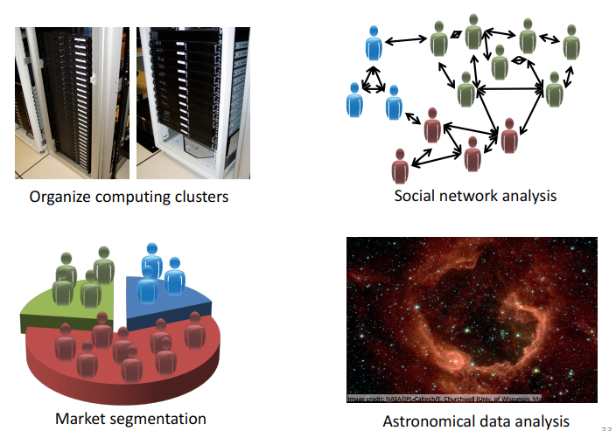
Unsupervised Learning

Slide 29
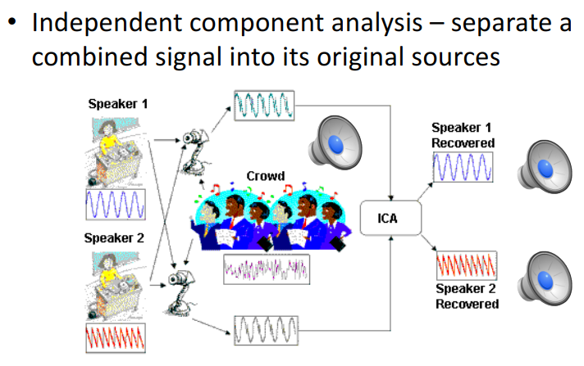
Unsupervised Learning

Slide 30
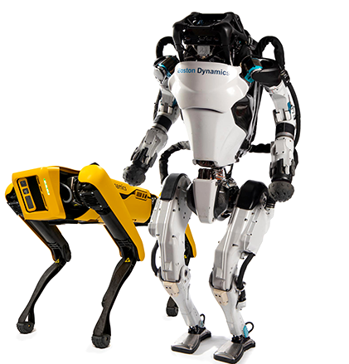
Reinforcement Learning
• Given a sequence of states and actions with (delayed) rewards, output a policy. – Policy is a mapping from states à actions that tells you what to do in a given state
• Examples: – Game playing – Robot in a maze – Balance a pole on your hand

Slide 31
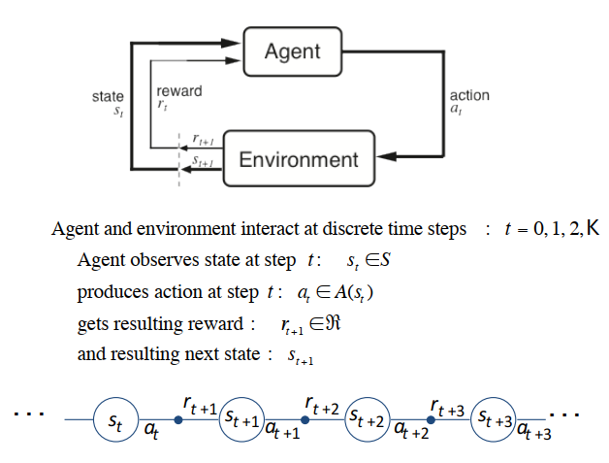
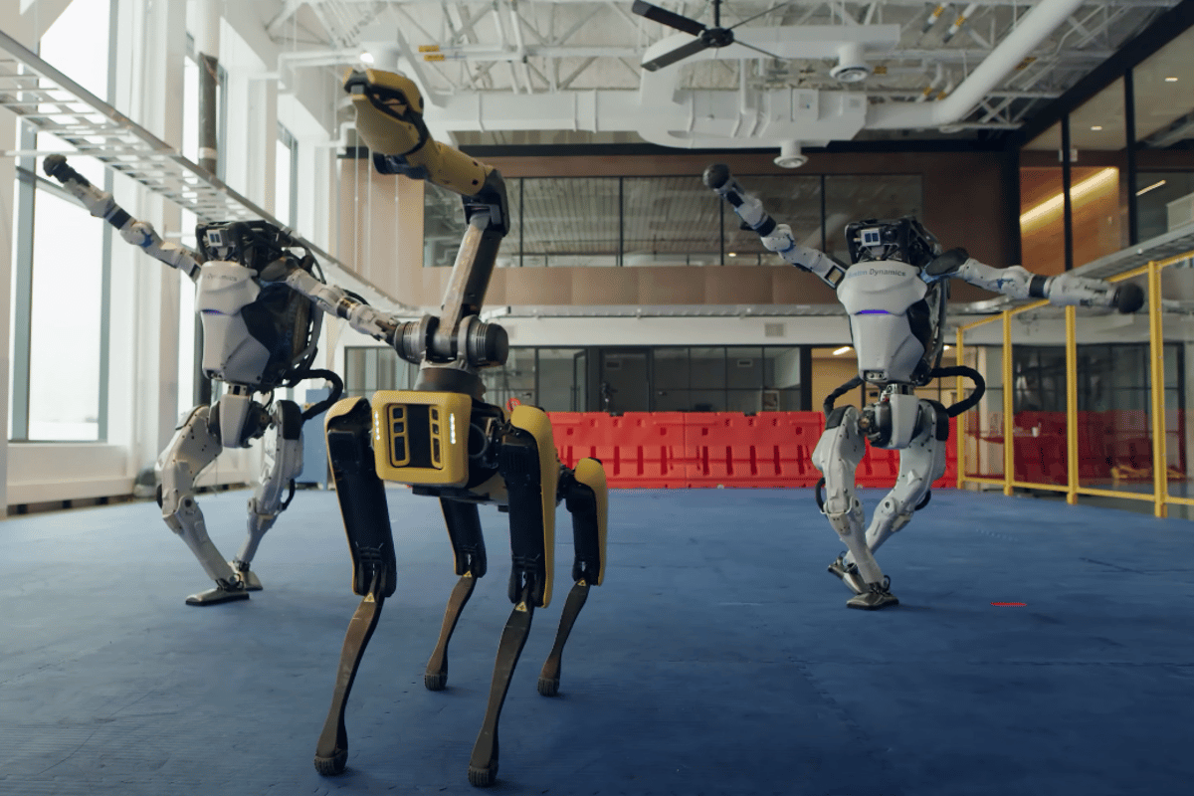
The Agent-Environment Interface

Slide 32
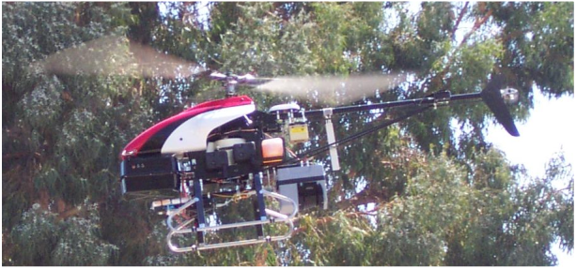
Inverse Reinforcement Learning
• Learn policy from user demonstrations
Stanford Autonomous Helicopter http://heli.stanford.edu/ https://www.youtube.com/watch?v=VCdxqn0fcnE

Slide 33
ML in a Nutshell
• Tens of thousands of machine learning algorithms – Hundreds new every year
• Every ML algorithm has three components: – Representation – Optimization – Evaluation

Slide 34

Various Function Representations
• Numerical functions – Linear regression – Neural networks – Support vector machines • Symbolic functions – Decision trees – Rules in propositional logic – Rules in first-order predicate logic • Instance-based functions – Nearest-neighbor – Case-based • Probabilistic Graphical Models – Naïve Bayes – Bayesian networks – Hidden-Markov Models (HMMs) – Probabilistic Context Free Grammars (PCFGs) – Markov networks

Slide 35

Various Search/Optimization Algorithms
• Gradient descent – Perceptron – Backpropagation • Dynamic Programming – HMM Learning – PCFG Learning • Divide and Conquer – Decision tree induction – Rule learning • Evolutionary Computation – Genetic Algorithms (GAs) – Genetic Programming (GP) – Neuro-evolution

Slide 36
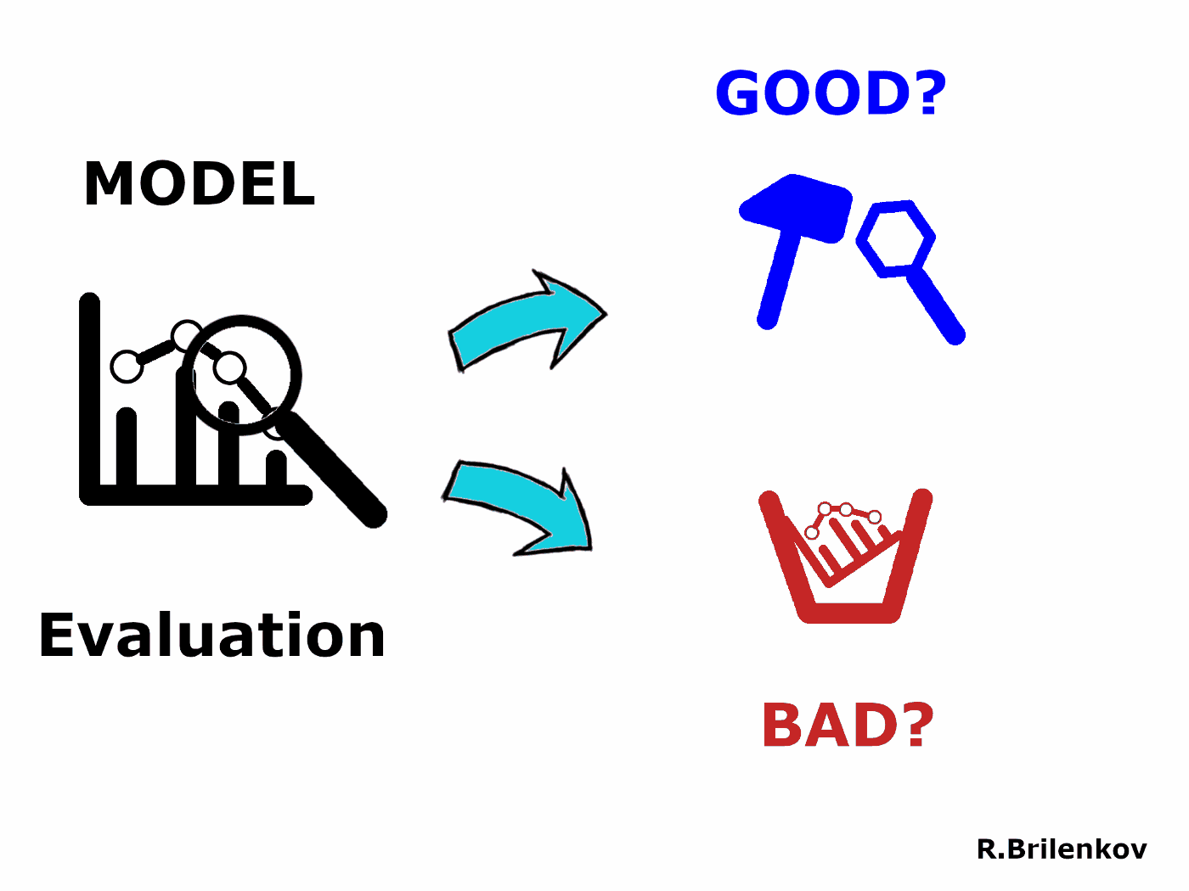
Evaluation
• Accuracy • Precision and recall • Squared error • Likelihood • Posterior probability • Cost / Utility • Margin • Entropy • K-L divergence • etc

Slide 37
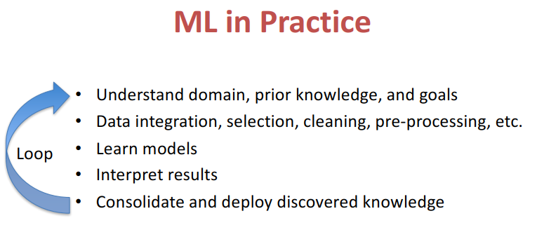

Slide 38










Python libraries for machine learning

Slide 39
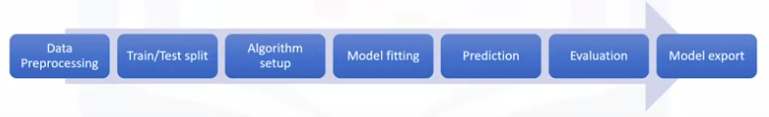
More about scikit-learn
Free software machine learning library
Classification, Regression and Clustering algorithms
Works with NumPy and SciPy
Great Documentation
Easy to implement

Slide 40
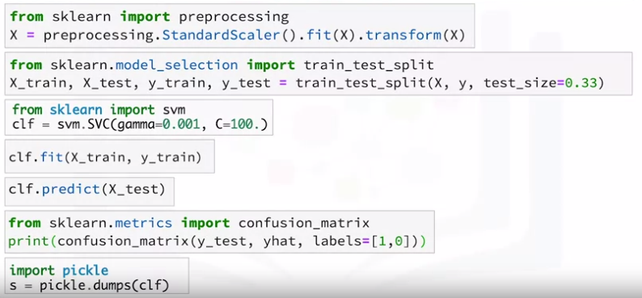
Scikit-learn functions

